Slide 1
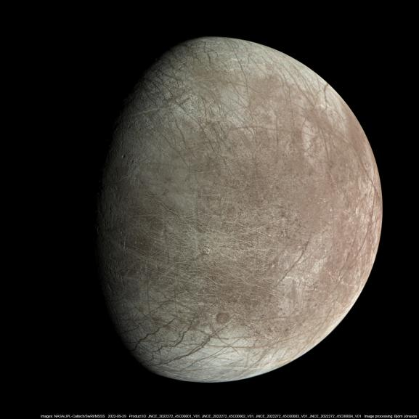




Viability of Methanogens In The Ice Shell of Europa
Veronica Klawender
Arizona Space Grant Symposium 2025
Dr. Daniel Apai, Dr. Matthew M Murphy
Steward Observatory, The University of Arizona
NASA Space Grant Consortium
Alien Earths Research Group

Slide 2
Main Question
What is the first order viability of terrestrial methanogens in the Europa’s ice shell environment?

Slide 3
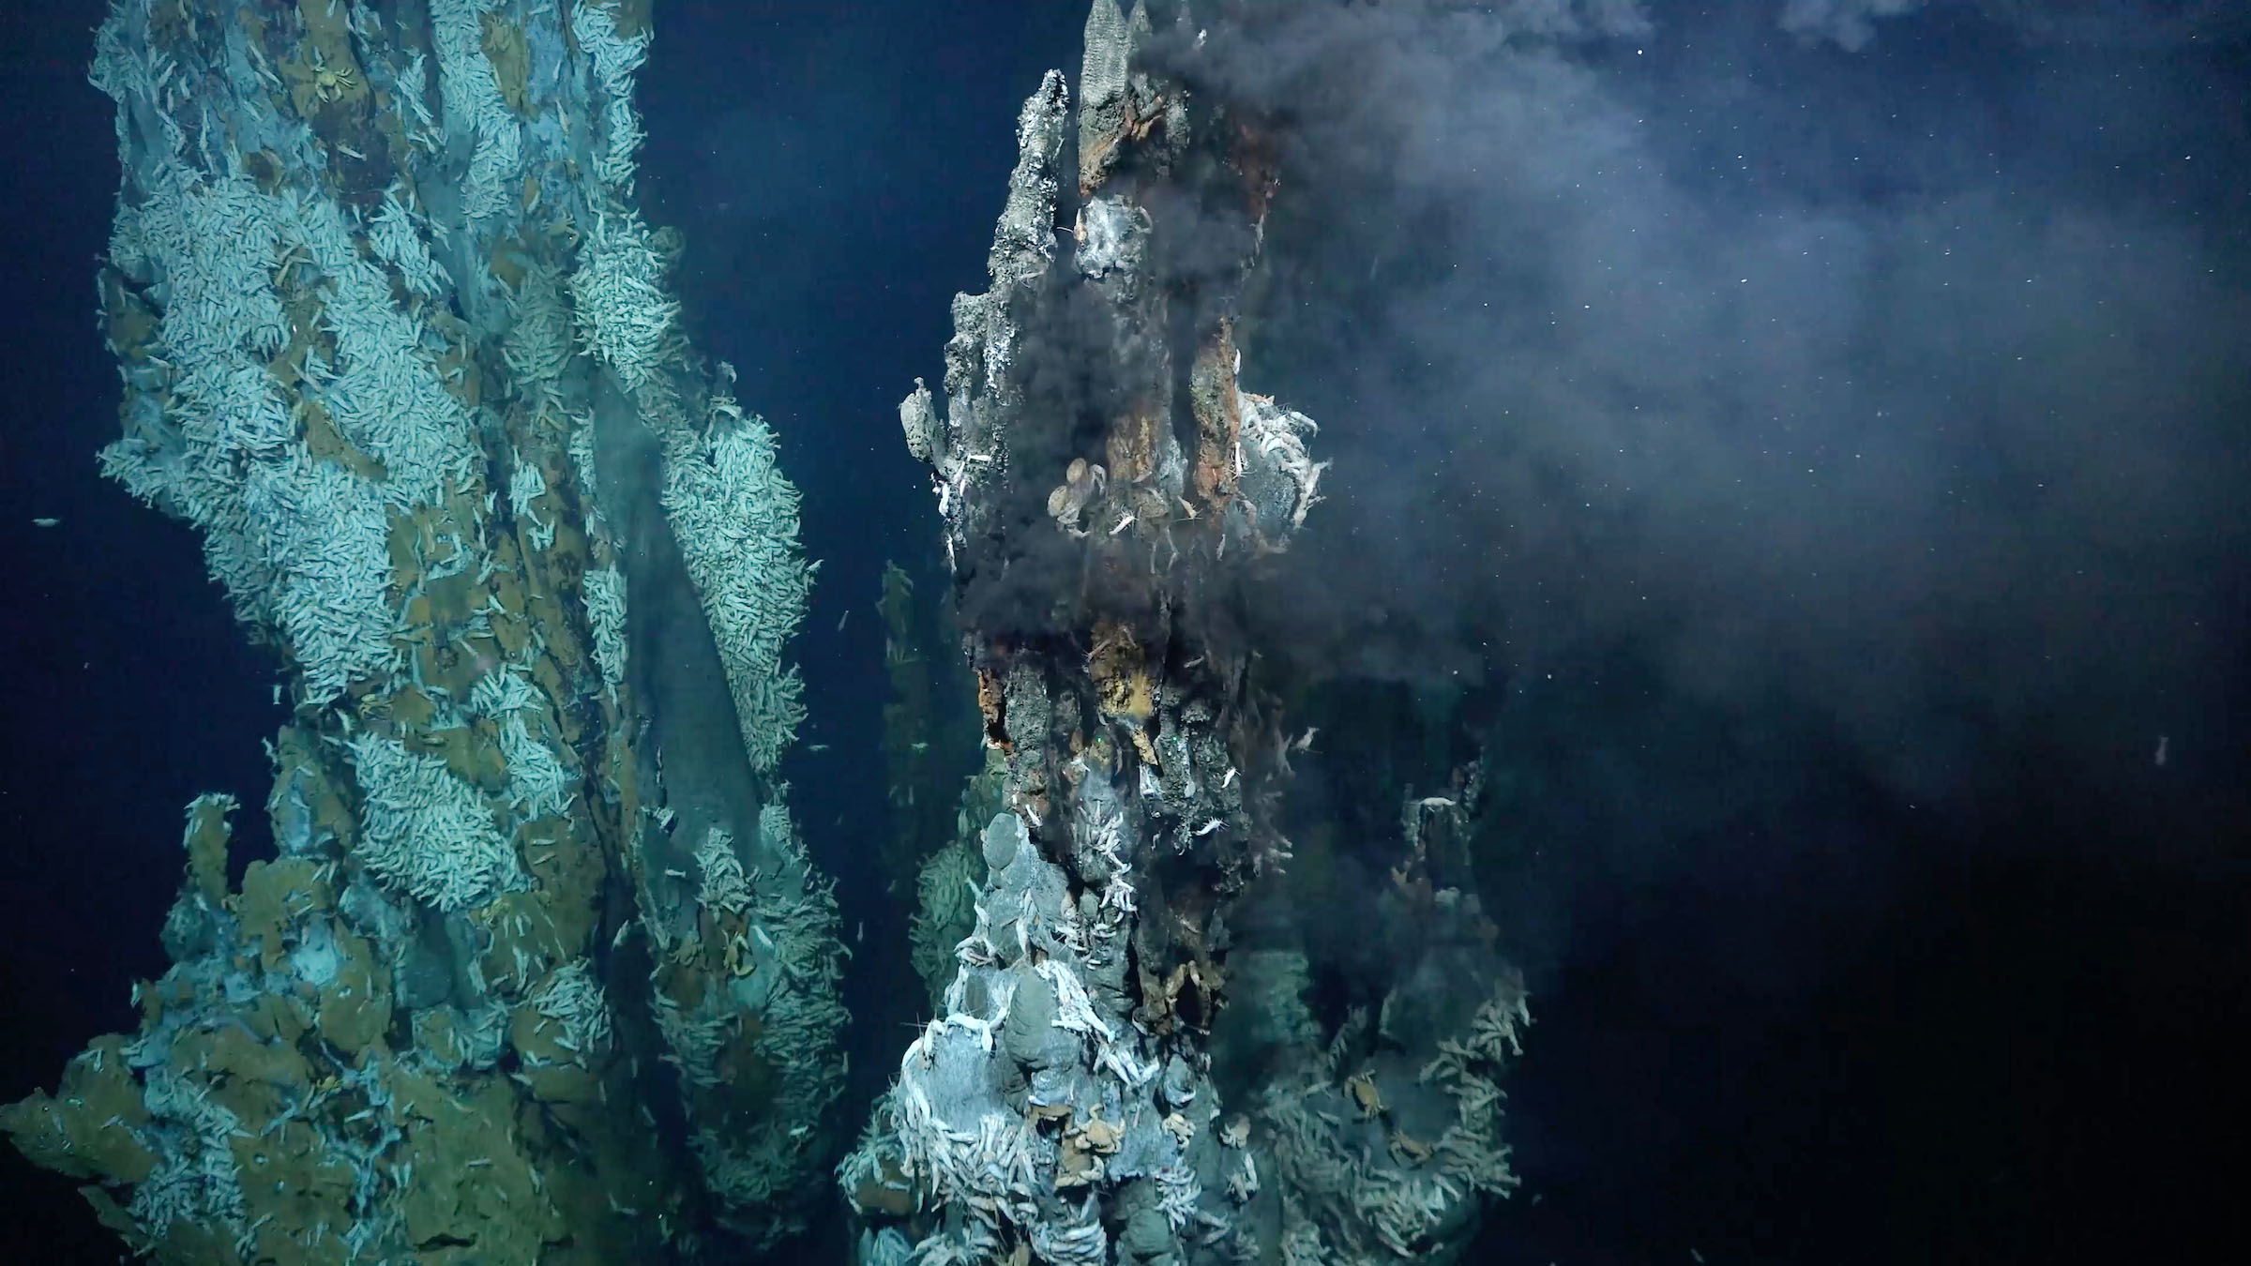
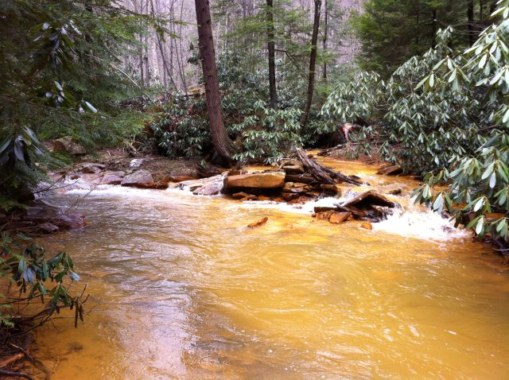
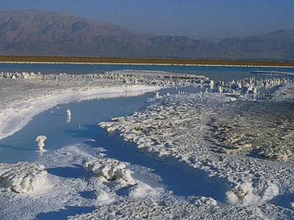
Background - Methanogens
Methanogenic organisms found in many extreme terrestrial niches
Temperature
Pressure
pH
Salinity
Buan 2018, Emerging Topics In Life Sciences , Saralov 2019, Microbiology
Image credit: US EPA, Schmidt Ocean Institute, Britannica

Slide 4
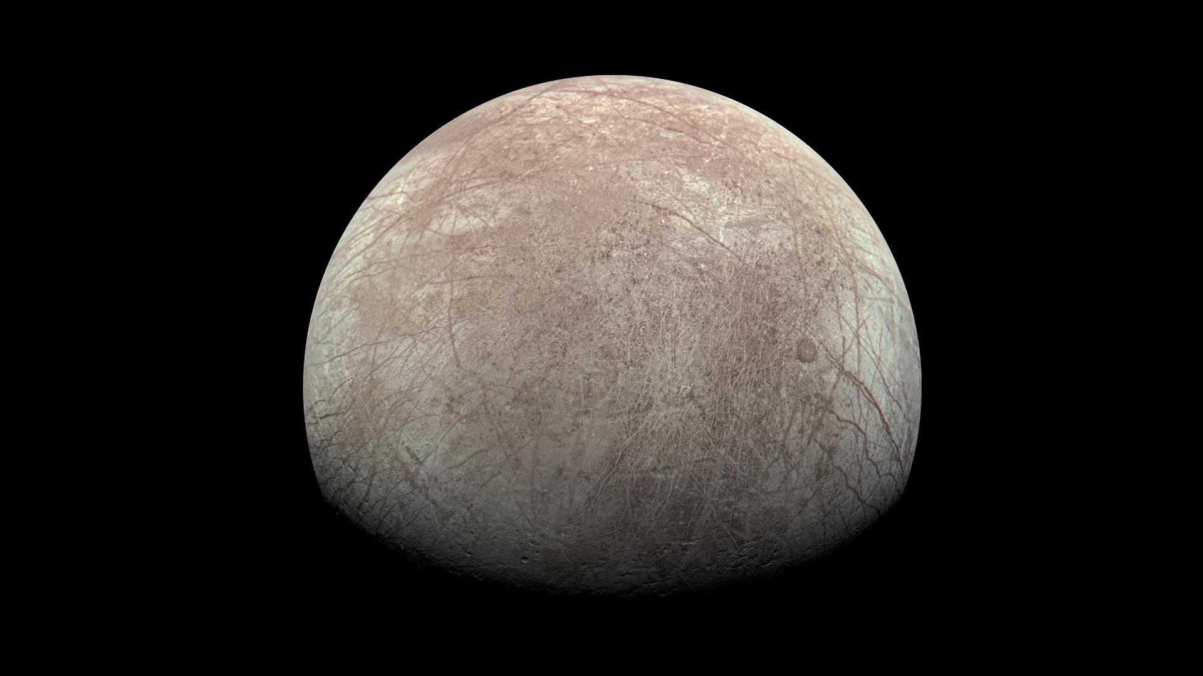
Background - Europa
Galilean moon of Jupiter
Similarly sized to Earth’s moon
Ocean world tidally locked to Jupiter and encased in an ice shell
Ice shell about 20-30 km thick
Ocean about 60-150 km deep
Image credit: NASA/JPL JunoCam
Greely et al. 2004, Jupiter

Slide 5
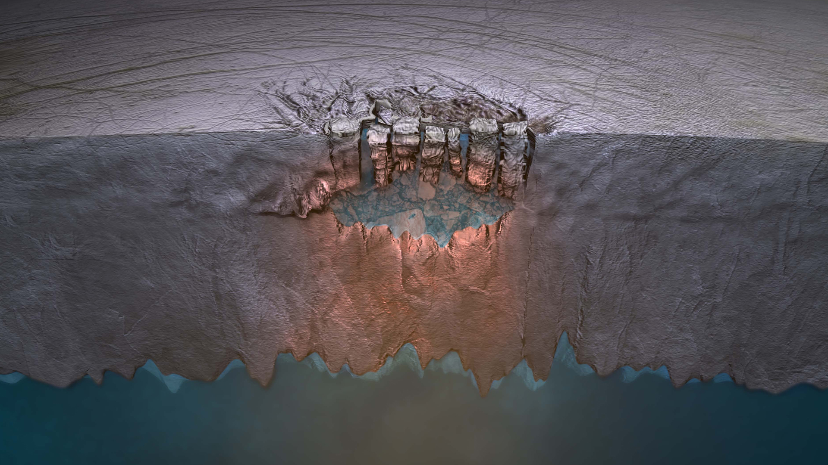
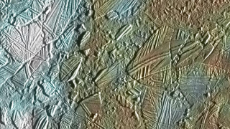
Chaos Terrains
Surface regions where ice has melted, shifted and refrozen
Thought to have at least 100,000 km^3 of water underlying ~3 km of ice, and radii as large as 50 km
2 well studied terrains: Conamara Chaos and Thera Macula
Image credit: NASA/JPL
Schmidt et al. 2011, Nature, Chivers et al 2023, PSJ

Slide 6
What is the viability of methanogens in a liquid water lens under a chaos region over time?

Slide 7
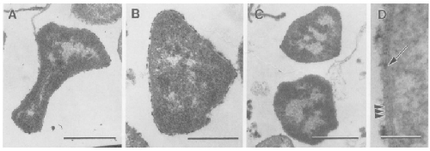
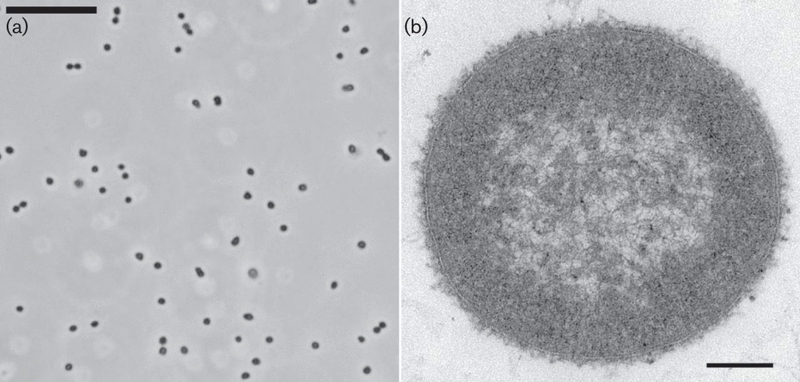
methanogens
Psychrophiles
Methanogenium frigidum – growth under 20℃
Halophiles
Methanohalophilus halophilus – growth at 146 ppt NaCl
Methanohalobium evestigatum – growth at 251 ppt NaC
Franzman et al. 1997, IJSEM
Katayama et al. 2014, IJSEM

Slide 8

Quantitative Habitability Framework
Self-consistent, universally applicable framework to define habitability as the viability of a particular metabolism in a specific environment
Calculates the probability of survival of a metabolic function by comparing known tolerable environmental conditions on Earth with the predicted conditions in an exoplanet or extraterrestrial habitat
Apai, Barnes et al. 2025, Planetary Science Journal, under review

Slide 9
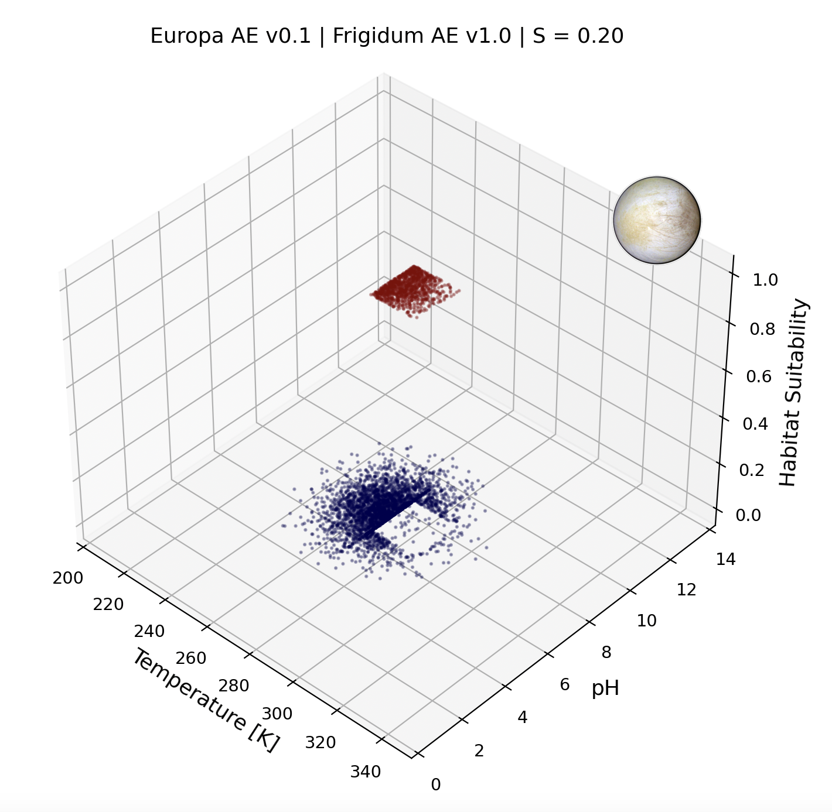
Temperature and pH vs suitability
M. frigidum:
pH: 6 – 8
Temperature: 273K – 293K
Habitat:
pH: 6 – 8
Temperature: 261K – 281K

Slide 10
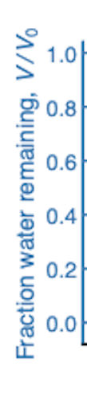
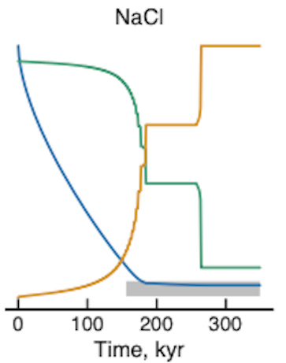
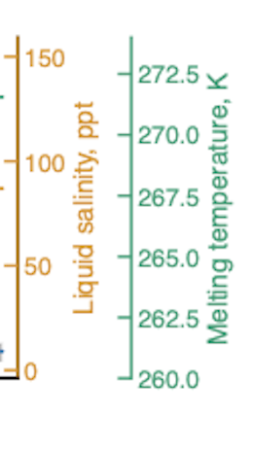
Salinity time profiles
Chivers et al 2023, The Planetary Science Journal

Slide 11
Time profiles for 5 methanogens
Representing evolutionary pressures over time in a chaos region:
5 Methanogens:
Methanobacterium flexile
Methanogenium frigidum
Methanosarcina siciliae
Methanohalophilus halophilus
Methanohalobium evestigatum
3 Timesteps:
0 – 150 kyrs
150 – 250 kyrs
250 – 350 kyrs

Slide 12
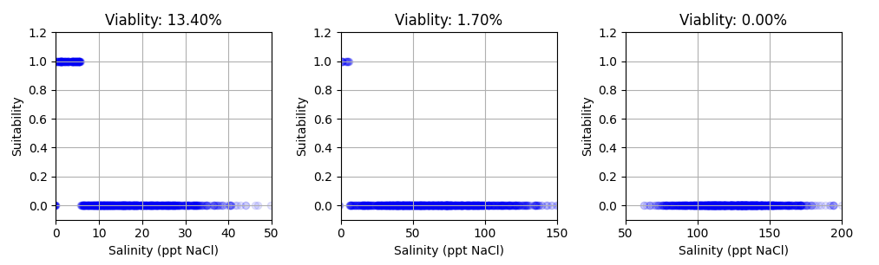
Suitability of Methanobacterium flexile
Timestep 1
Timestep 2
Timestep 3

Slide 13
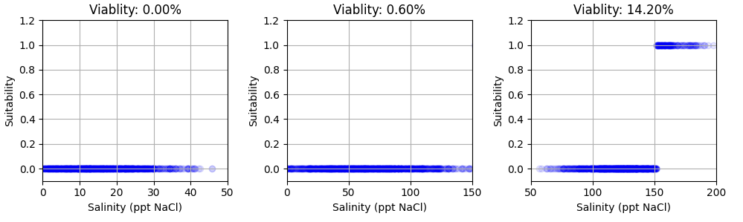
Suitability of Methanohalobium evestigatum
Timestep 1
Timestep 2
Timestep 3

Slide 14
Salinity is a key limiting factor for any biological functions within Chaos terrains

Slide 15
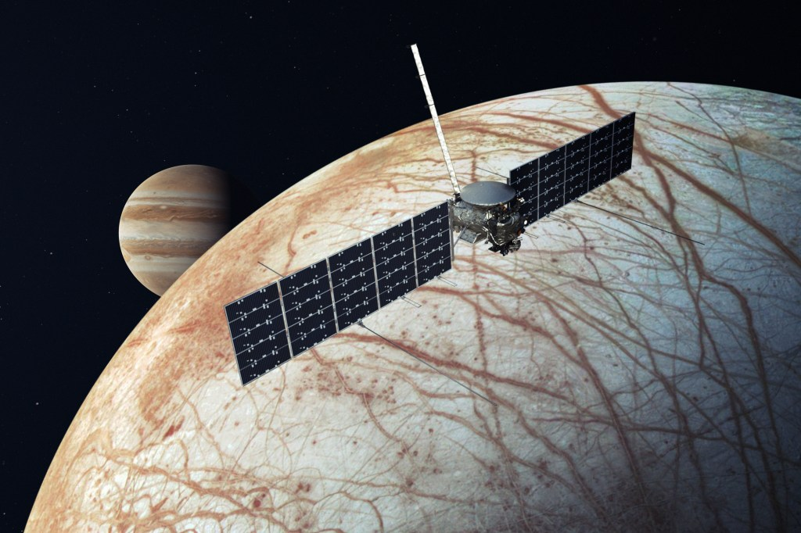
Implication
Europa Clipper Mission
Chaos terrains are:
Shallow
Accessible
Visible
Well studied
Future sampling missions/landers
Image credit: NASA/JPL

Slide 16
Acknowledgements
Dr. Daniel Apai
Matthew M. Murphy
Michelle Coe and the Arizona Space Grant Consortium
Alien Earths Research Group
Atmospherica Team

Slide 17
Summary
Chaos terrains in the ice shell of Europa may represent significant bodies of water representative of the composition of the ice and decoupled from the ocean.
These water lenses may persist on timescales of millions of years.
Over time, salinity becomes a limiting factor for biological functions, and there is heavy evolutionary pressure to evolve necessary mechanisms of adaptation.
Thank you!
Veronica Klawender
vklawender@arizona.edu

